Slide 1
Product Development -
Tools For Creators Presentation
VidSpark AI -
Revolutionizing Content Creation with AI

Slide 2
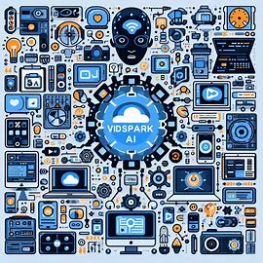
Highlights
Company Overview
Product Goals: Delivering Excellence
Our Team
Aligning Goals with Our Purpose
Who we serve: Our Targets
User Needs: What We Address
Our Solutions: Meeting The Needs
Design Journey: MVP Roadmap
Our Mission and Vision
Our Products
Business Goals: Fueling Our Growth

Slide 3
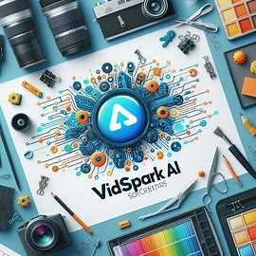
Company Overview
Introduction
Welcome to VidSpark AI, your ultimate AI-powered video creation platform.
Mission
Empowering creators to effortlessly produce captivating video content. We strive to develop innovative solutions that streamline the creative process, foster collaboration, and enable creators to bring their visions to life.
Vision
Democratizing content creation by blending AI with human creativity. To empower creators with intuitive and powerful tools that transform their creative process
Products
Introducing VidSpark AI Studio, your all-in-one video editing suite

Slide 4
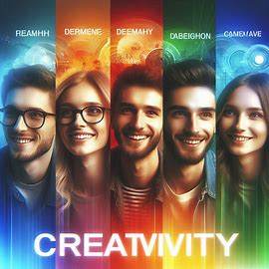
Our Team
•John Smith: (Graphic Designer, Expert in user-centric design and branding)
•Jane Drake: (UX/UI Designer, 5+ years experience in digital art tools)
•Alice Johnson: (Full-Stack Developer)
•Bob Brown: (Front-End Developer, Interactive UI specialist)
•Charlie Green: (Back-End Developer, Scalable cloud solutions)
Tools: Figma, Adobe Illustrator

Slide 5
Design Process: End-to-Ends for MVP
•Research: Surveys, focus groups, competitor analysis using Google Analytics, User Interviews
•Ideation: Brainstorming, mind mapping using Miro, Trello
•Wireframing: Figma
•Prototyping: Figma, InVision
•Testing: Usability testing, A/B testing using UsabilityHub, Maze
•Iteration: Figma, JIRA
•Development: Agile sprints, GitHub, Visual Studio Code
•Launch: Beta, marketing campaigns using Mailchimp, Google Ads
•Feedback & Iteration: User feedback forms, analytics using Hotjar, Mi

Slide 6
Design Journey: MVP Roadmap
Research: Uncover needs and competition.
Ideate: Generate innovative solutions.
Wireframe: Visualize the basic layout.
Prototype: Create interactive mockups.
Test: Gather user feedback.
Iterate: Refine the design.
Develop: Build the product.
Launch: Release the MVP.
Feedback & Iterate: Learn and improve continuously.

Slide 7

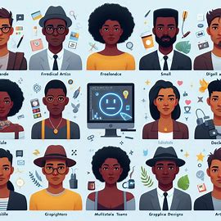
Vision and Mission Goal
Mission
Break down barriers to video creation with intuitive AI tools.
Foster a community of creators who inspire and learn from each other.
Vision
Become the go-to platform for AI-assisted video production.
Transform how stories are told and shared through video.

Slide 8
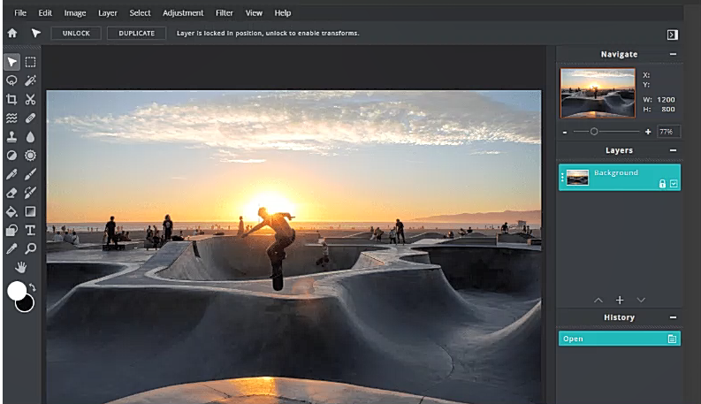
Our Products
AI-Assisted Editing: Smart suggestions for cuts, transitions, and effects.
Automated Subtitling: Save time and reach a wider audience.
Content Recommendation Engine: Find the perfect music, sound effects, and stock footage.
Trend Analysis Tools: Stay ahead of the curve with data-driven insights.

Slide 9
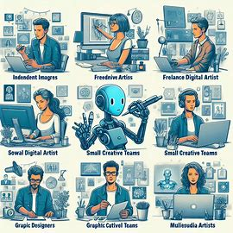
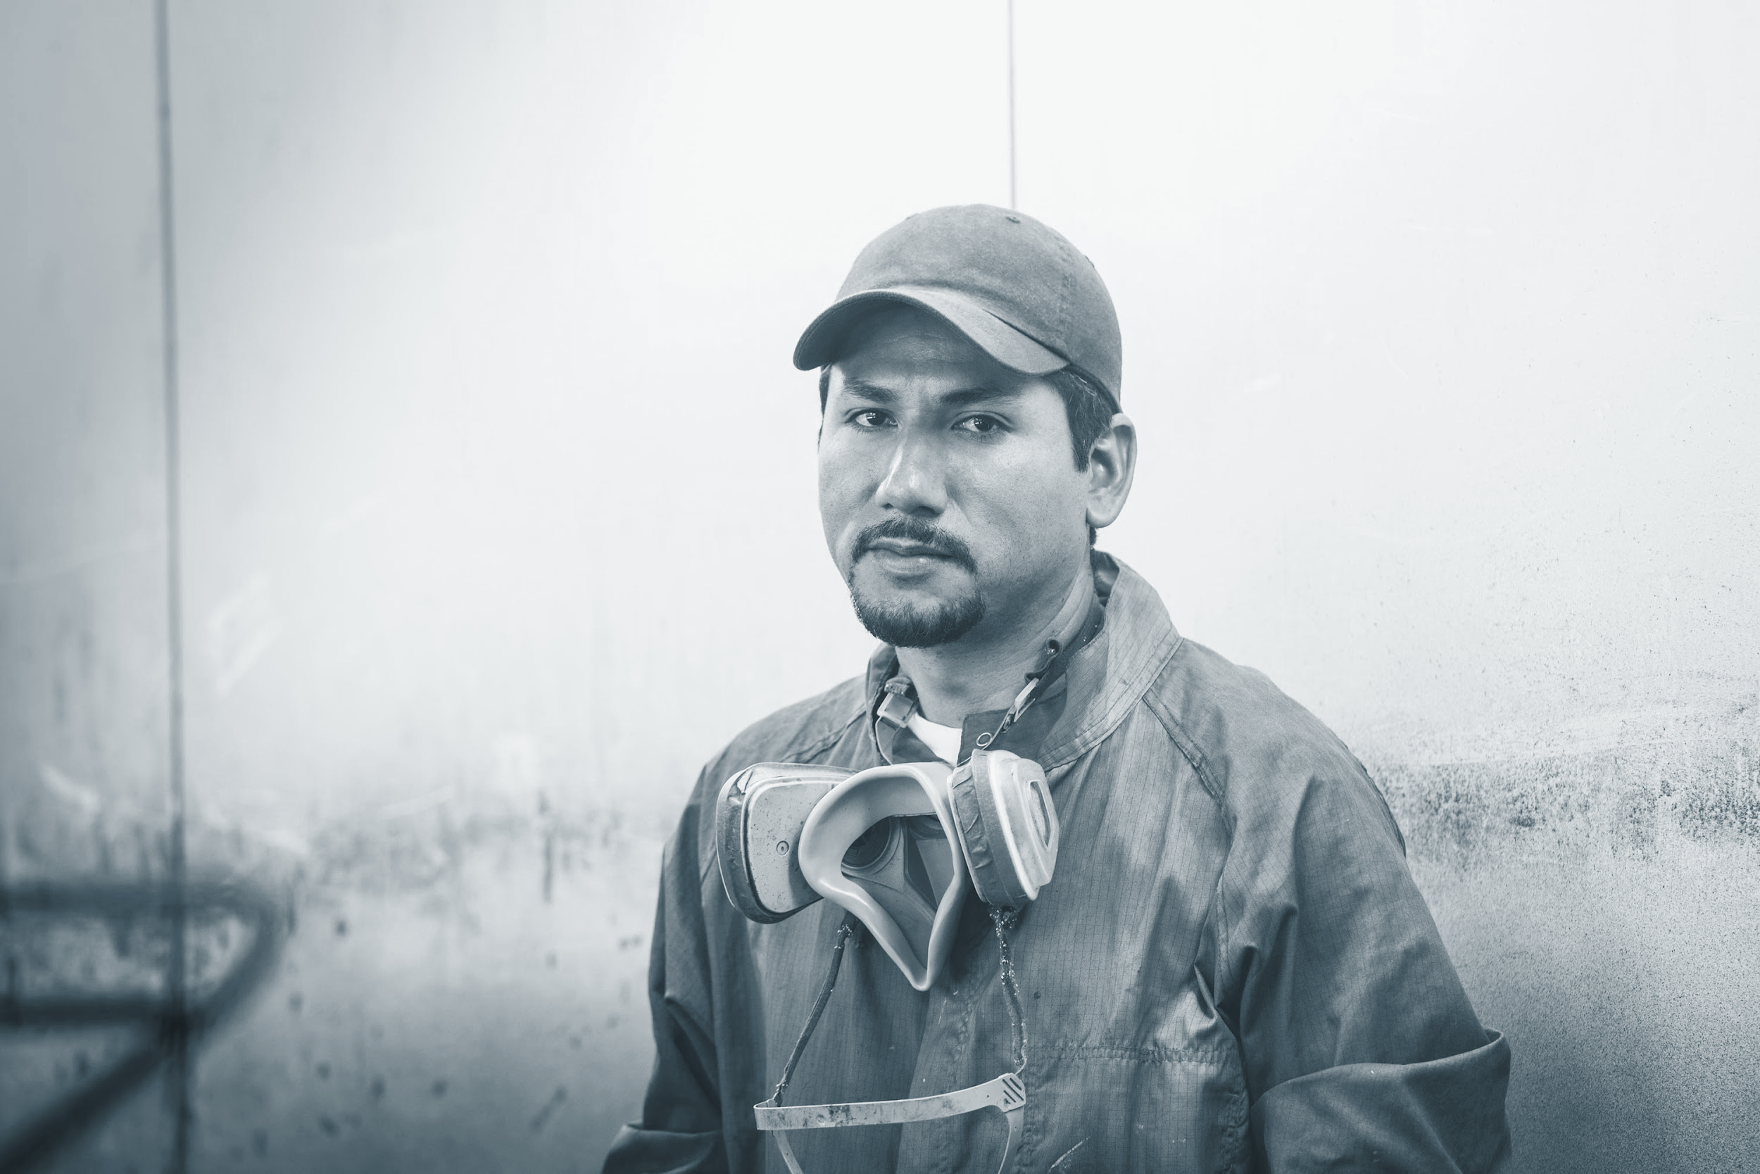


Who We Serve: Target Users
Primary Target Users
Digital artists
Freelance video creators
Social media influencers
Broader Target Users
Small creative teams
Educators and trainers
Businesses needing marketing videos

Slide 10

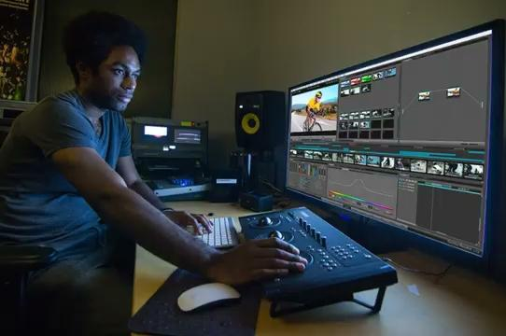

User Needs: What we Address
How our tools work across different devices
List of Key User Needs:
Seamless collaboration
Intuitive UI
Robust editing tools
Cross-platform access
Efficient asset management

Slide 11

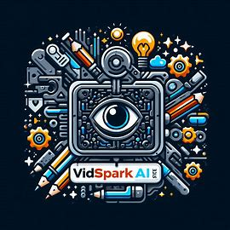
Our Solutions: Meeting the Needs
Friendly user interface
Editing Tools
AI Interactive features
Interactive Elements
File Management
Real time collaboration
Brand identity builder
Content strategy planner

Slide 12
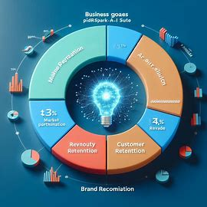
Fuel Growth
Market Penetration
04
Customer Retention
Revenue Growth
Brand Recognition
01
03
User Acquisition
User Feedback
Feature Completeness
Innovation
02

Slide 13
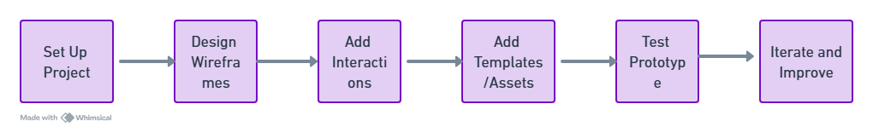
Project timeline
Jan
FEB
MAR
APR
MAY
JUN
Market research and ideation
Visualize the basic layout
Design wireframes & prototypes
Develop MVP
Conduct Alpha testing with group of users
Launch

Slide 14
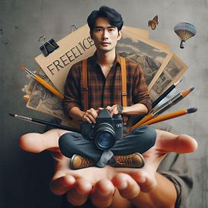
Thank you!
“Let’s Create Together”
BSA 2024

